Slide 1
Bazele inteligenței artificiale
Laborator – Grigore Ionuț

Slide 2

today’s lab

Slide 3
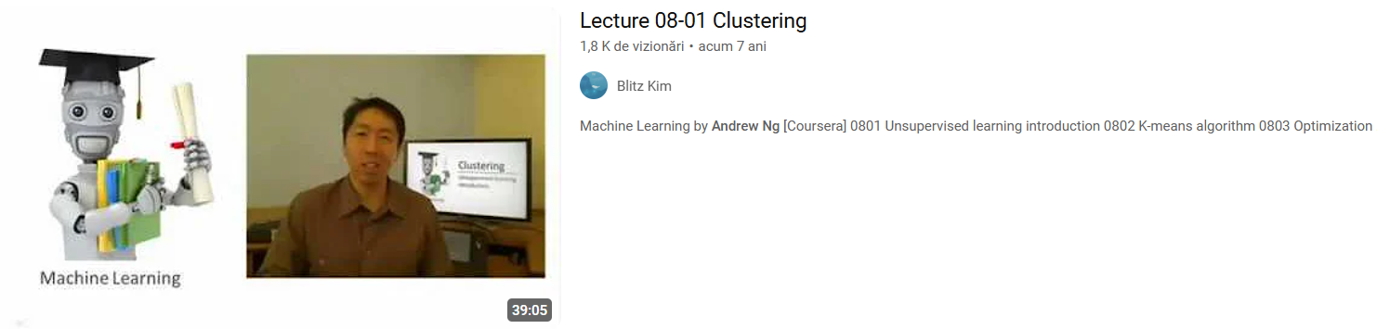
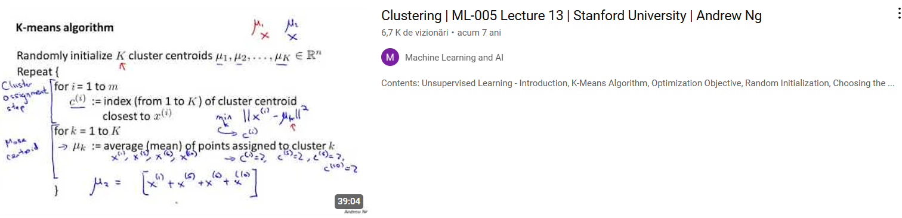

Slide 4
Content
Clustering - overview
K-means clustering
Agglomerative clustering
DBSCAN
Evaluating clustering methods

Slide 5
1) Clustering

Slide 6

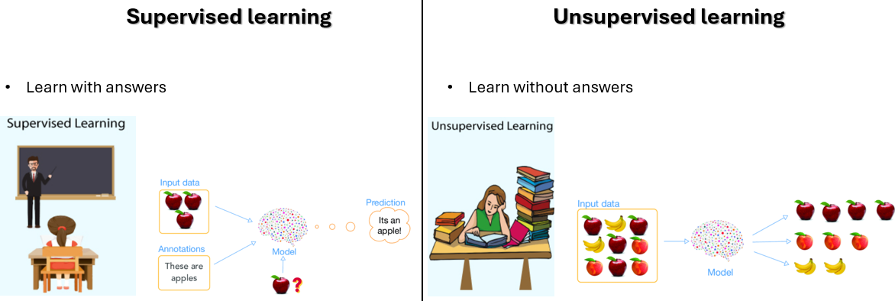
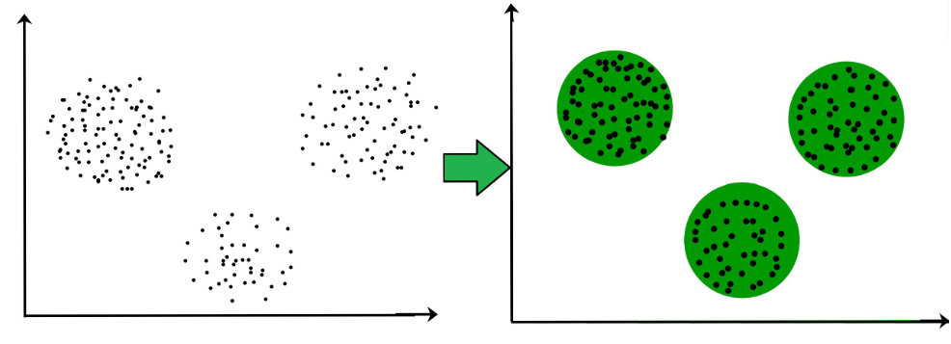
it’s an unsupervised task
TL;DR: groups similar objects together into clusters
from lab 1 ☺

Slide 7
2) K-means clustering

Slide 8
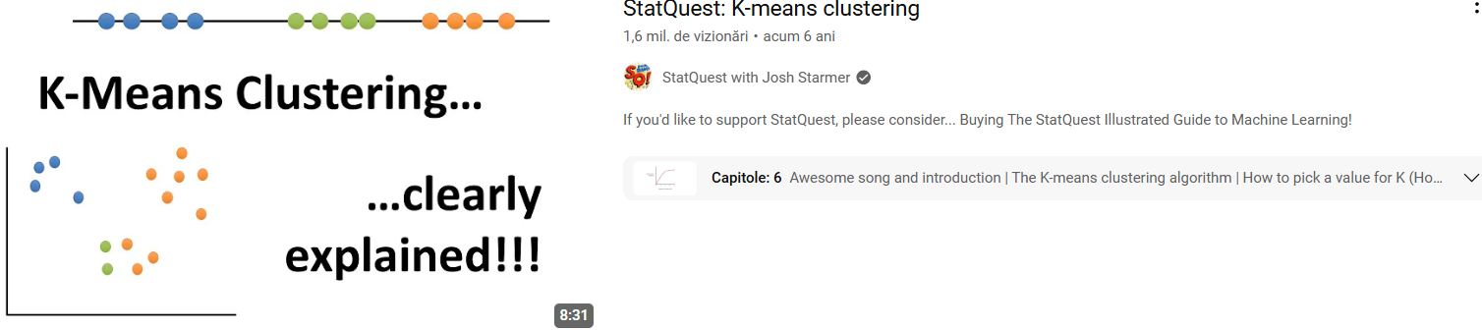

Slide 9
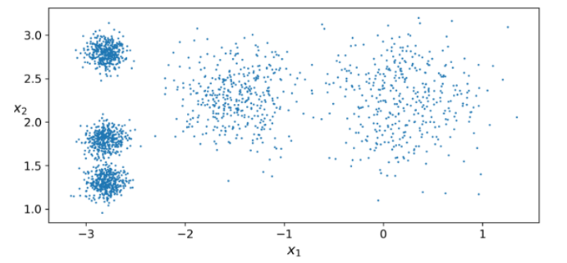
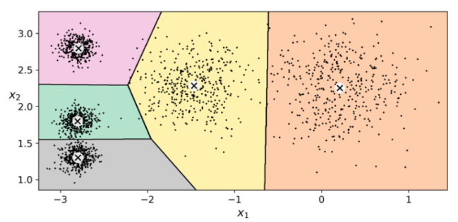
we can see here 5 blobs of points
goal: find the center of each blob
assign new points to the closest center

Slide 10
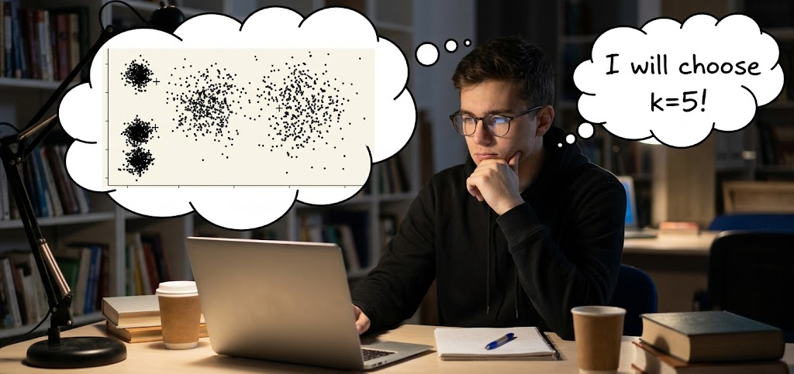
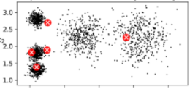
K-means steps
1. Choose the Number of Clusters (k)
2. Initialize centroids: Pick k random data points to serve as starting centers.

Slide 11
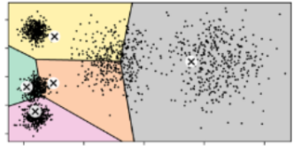
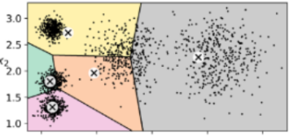
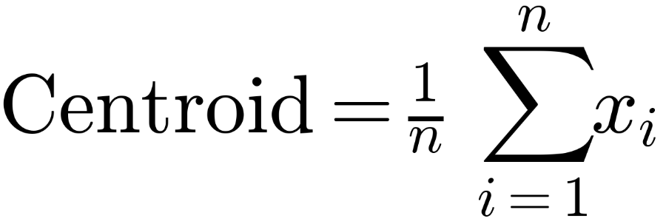

3. Assign points: Assign each point to its nearest centroid (typically using Euclidean distance).
3. Update centroids: Recompute each centroid as the mean of its assigned points:
5. Repeat until convergence: Alternate Steps 3 and 4 until centroids stop shifting or max iterations are reached.

Slide 12
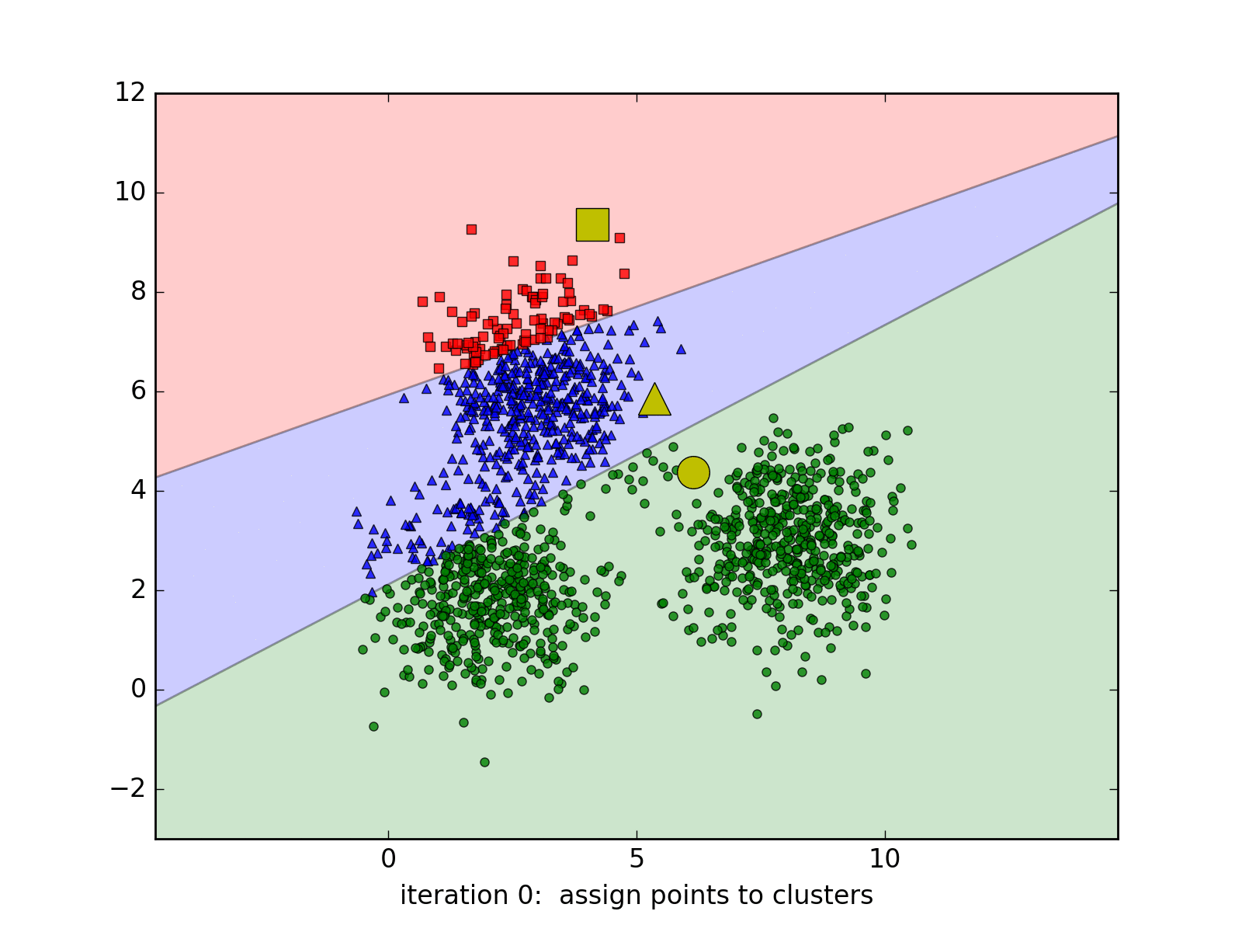

Slide 13
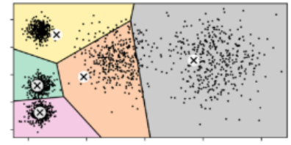
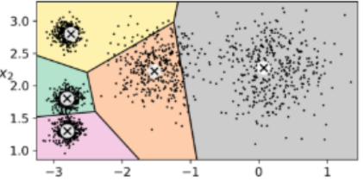
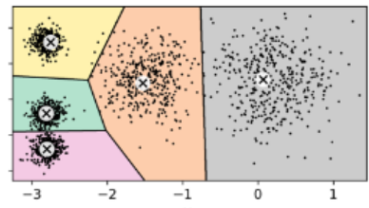
randomly initialize cluster centroids
assign points to clusters
update the centroids
assign points to clusters
update the centroids
assign points to clusters
,
q.e.d.

Slide 14
but…

Slide 15
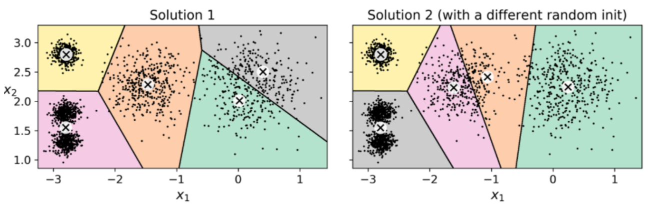

NOTE:
2 bad solutions
K-means is very sensitive to random initialization of the cluster centroids !

Slide 16


Slide 17



SOLUTIONS:
run K-means multiple times with different random initializations and keep the best solution
use K-means++ which introduces a smarter initialization of the cluster centroids

Slide 18

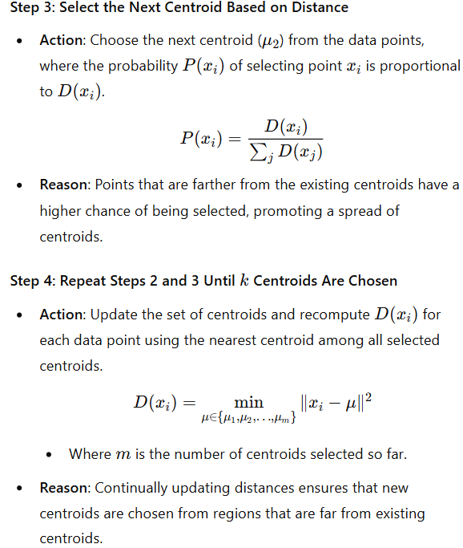
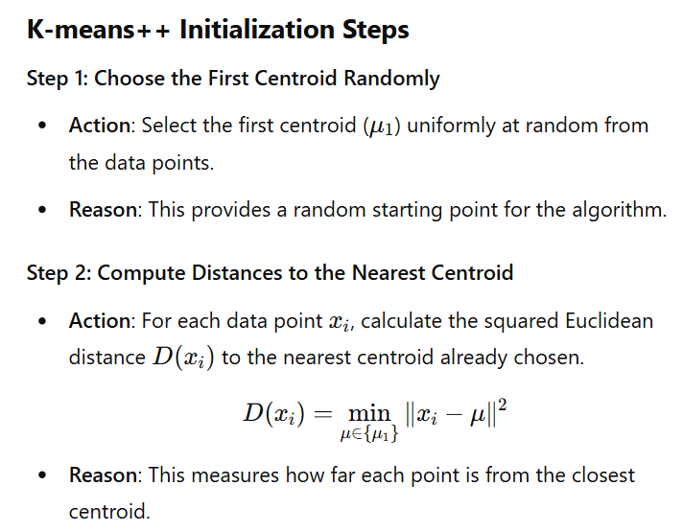

Slide 19
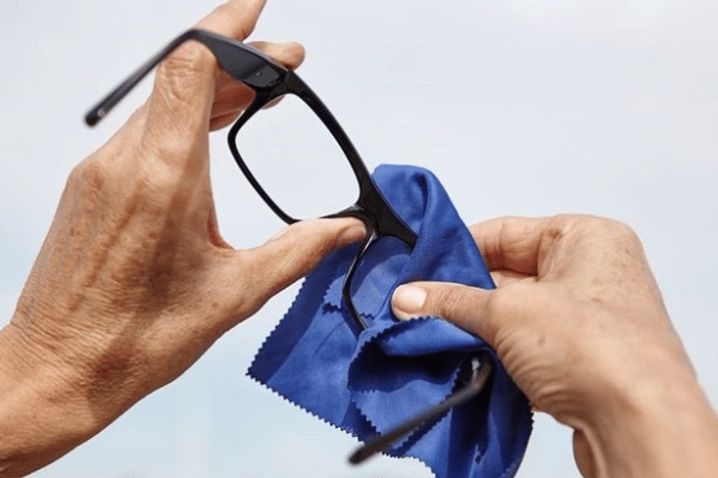
K-means++ = smarter initialization of the centroids

Slide 20
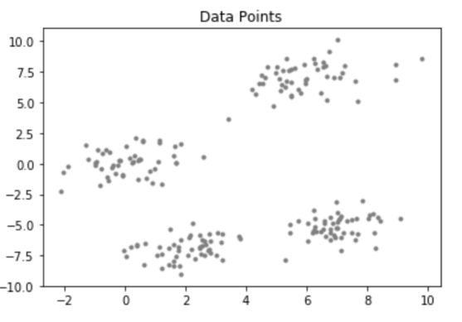
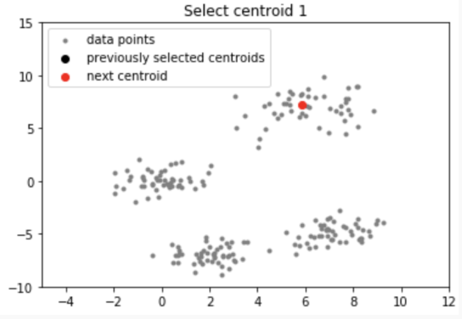
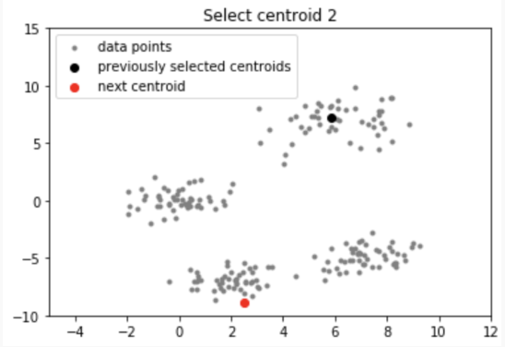
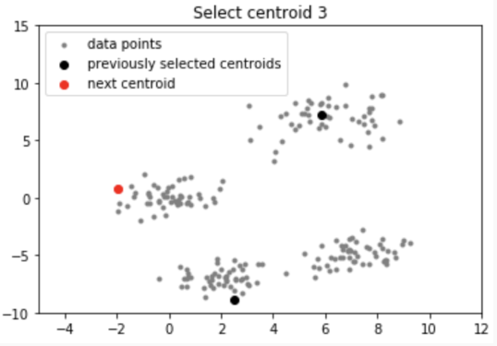
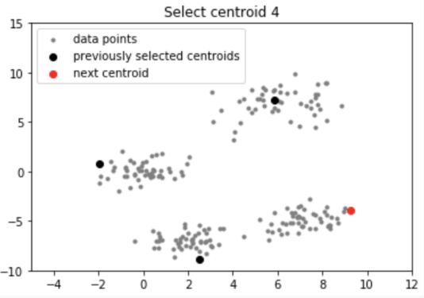
"++"
K-means

Slide 21


Slide 22
How do we choose the optimal k?

Slide 23
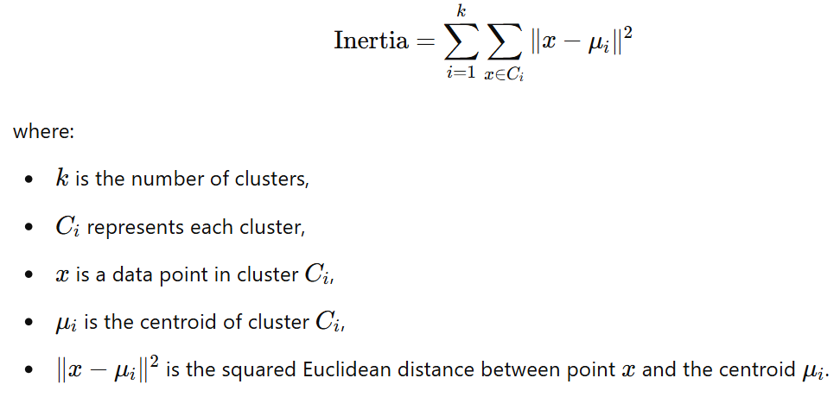
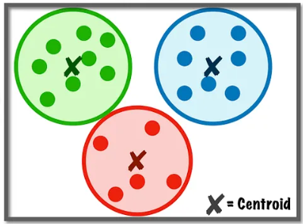

We have 2 performance metrics:
1) inertia
2) silhouette score
1)
Inertia: it’s the sum of squared distances between each data point and its assigned cluster’s centroid
d₁
d₂
d₄
d₅
d₃
d₆
e.g.
d₇
d₈
d₉

Slide 24
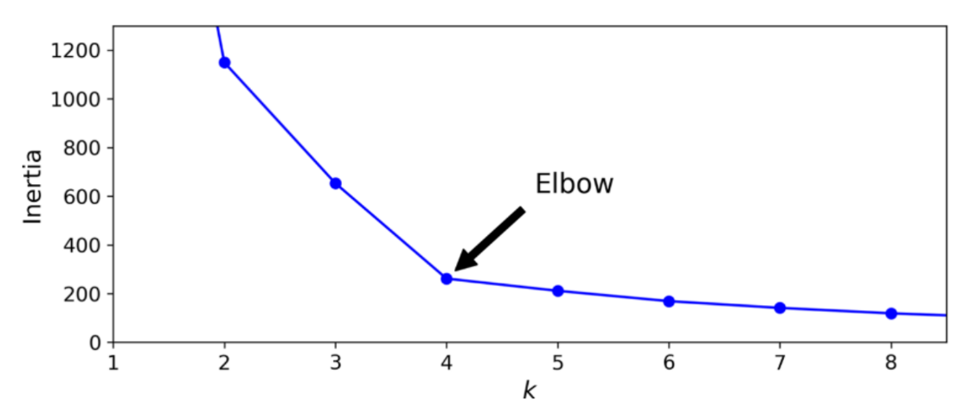
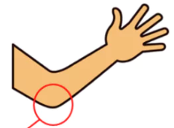
We choose the optimal number of clusters k using the elbow method !

Slide 25
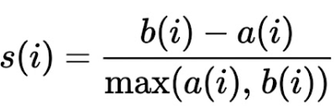
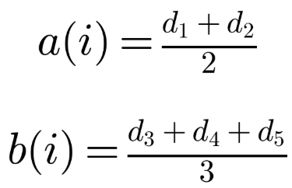
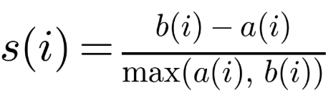
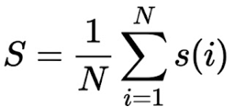
2)
silhouette score:
Compute silhouette score for point i:
where:
a(i) = mean distance to other points in the same cluster
b(i) = mean distance to points in the nearest neighboring cluster
i
d₁
d₂
e.g.
d₄
d₃
d₅
Compute Overall Silhouette Score:

Slide 26
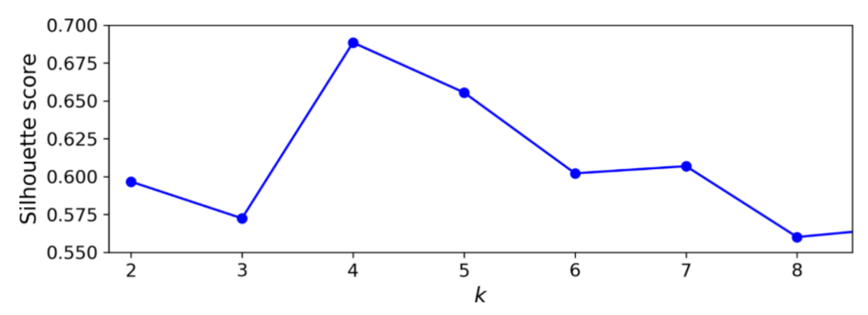
best choice (the highest score)

Slide 27
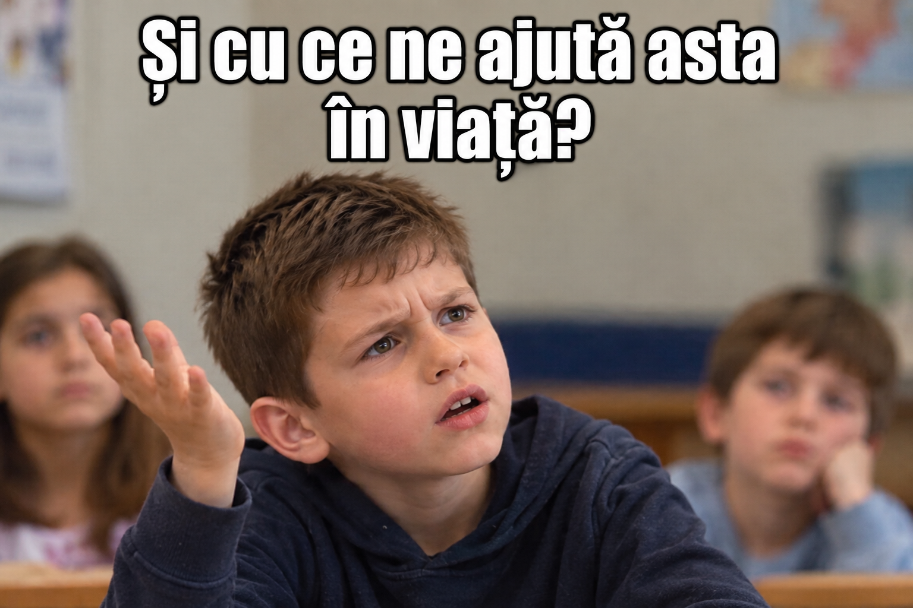

Slide 28
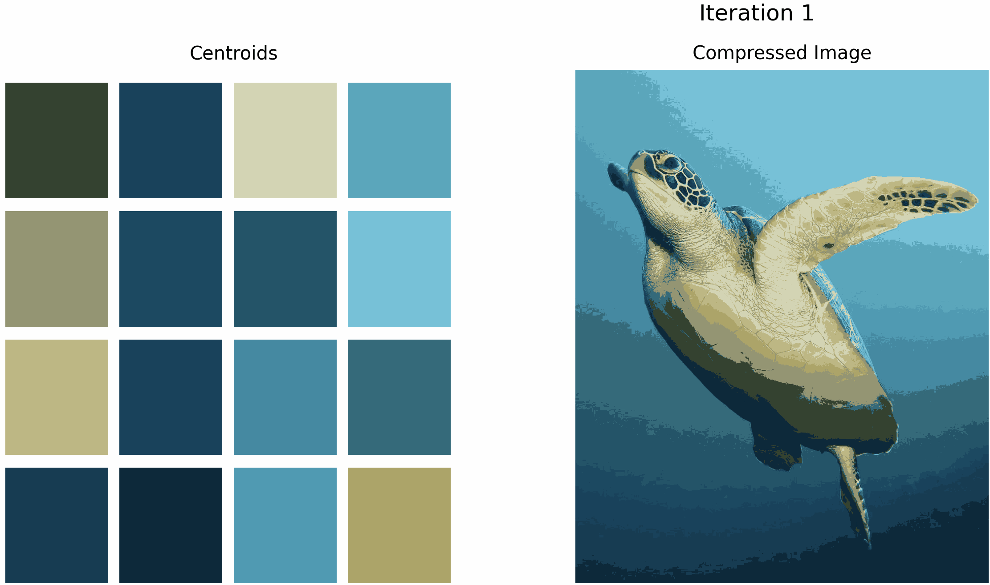

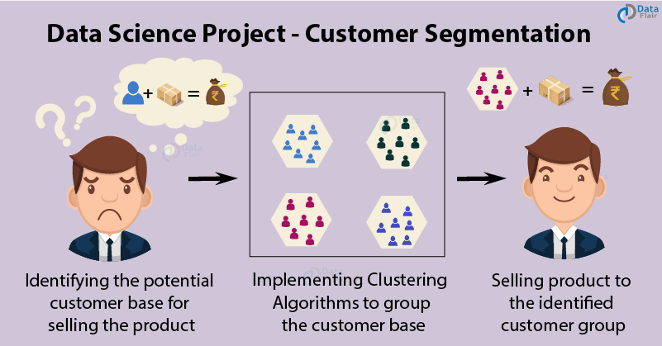

K-Means Image Compression
Convert each pixel → 3D point [R, G, B]
Choose k = number of colors to keep (e.g., 16).
Apply K-Means
Replace each pixel with its centroid color → compressed image
Store palette (k colors) + pixel indices → smaller file.
Customer Segmentation with Clustering
Goal: Group customers with similar behavior or preferences.
Input: Data like age, income, spending habits, region, etc.
Method: K-Means
Result: Each cluster = a distinct customer segment
(e.g. “budget buyers”, “premium spenders”).

Slide 29
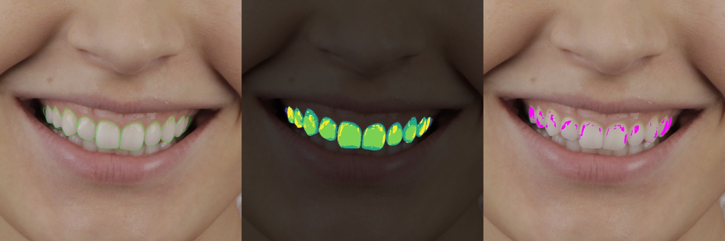
Finding specular highlights on teeth with clustering
Step 3 (Cluster): Apply K-Means (k=6) to group pixels with similar feature values.
Step 4 (Identify): Select the cluster with the highest local contrast to isolate the specular highlights.
Step 1 (Segment): Outline the teeth using a segmentation model.
Step 2 (Extract Features): Describe each pixel using 3 values:
  Brightness
  Color tint (white vs. slightly yellow enamel)
  Local contrast (how much brighter it is than neighboring pixels)

Slide 30
Code part

Slide 31
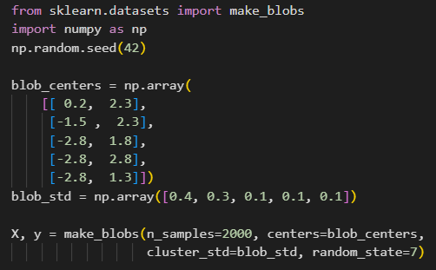
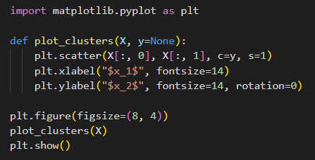
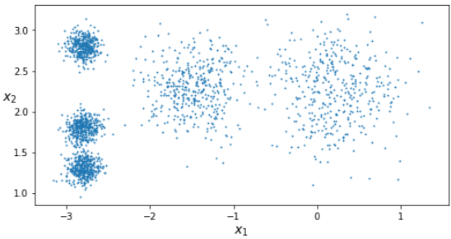

Slide 32
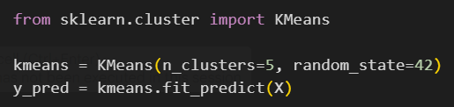
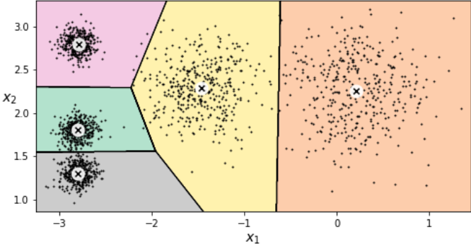
plot_decision_boundaries() function from lab☺

Slide 33
3) Agglomerative clustering

Slide 34
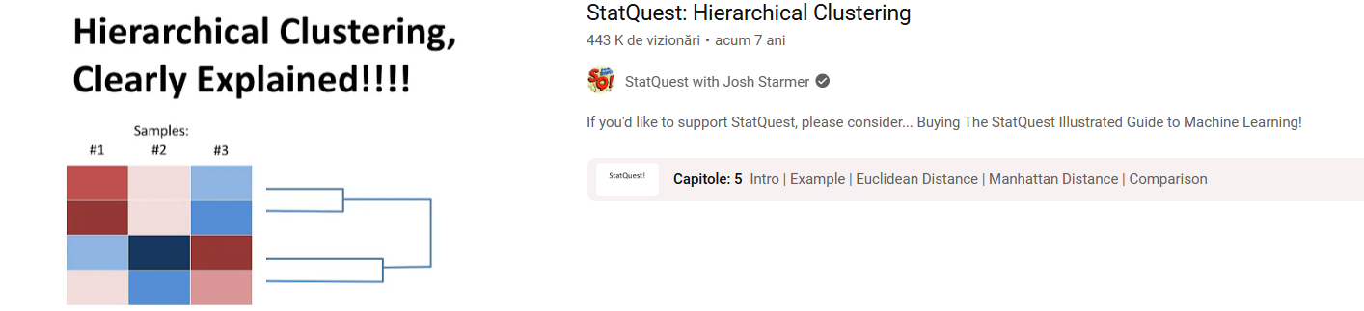

Slide 35
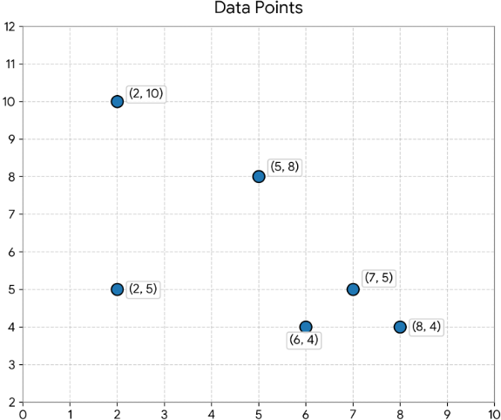

Agglomerative Clustering steps
1. Initialize: Each data point starts as its own cluster (n points ⟶ n clusters).

Slide 36
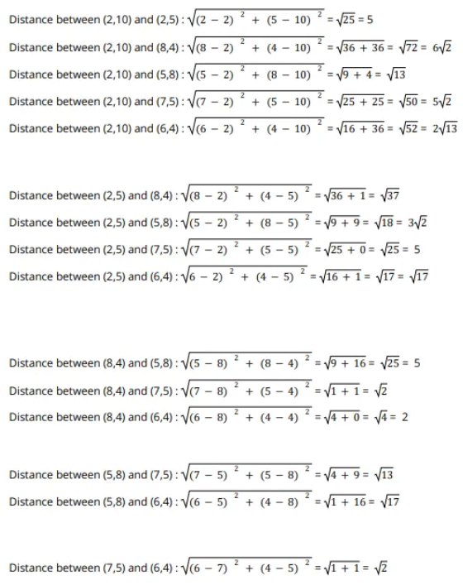
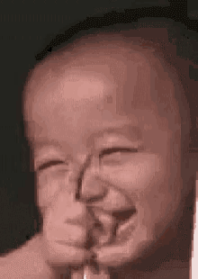
Agglomerative Clustering steps
2. Compute Distances: Measure pairwise distances between all clusters (e.g., Euclidean).

Slide 37
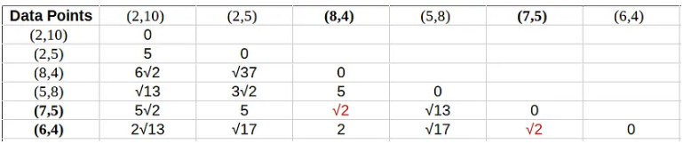
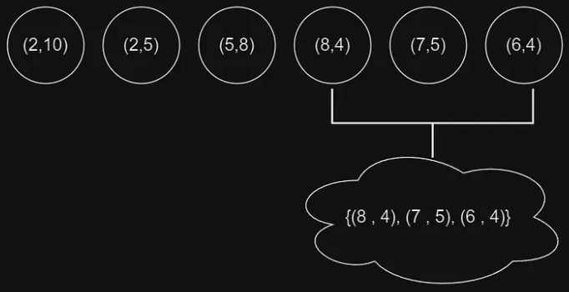
Agglomerative Clustering steps
3. Merge: Combine the closest clusters into one.

Slide 38

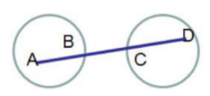

Agglomerative Clustering steps
4. Update Distances: Recalculate distances to the new cluster via linkage:
single linkage clustering → distance between the closest pair
complete linkage clustering → distance between the farthest pair
average linkage clustering → average distance between all pairs

Slide 39


Agglomerative Clustering steps
5. Repeat: Iterate steps 3–4 until stopping criteria are met
(target k, distance threshold, or 1 final cluster).
3.
4.
k=2

Slide 40


Slide 41



Slide 42
Code part

Slide 43



Slide 44



Slide 45
4) DBSCAN
(density-based spatial clustering of applications with noise)

Slide 46


Slide 47



DBSCAN: Arbitrary shapes ⋅ Noise-tolerant ⋅ No predefined number of clusters
DBSCAN relies on 2 parameters:
  ε: maximum distance between 2 points in the same cluster.
  m: minimum points within a distance of ε for a point to be considered a core point.
x
x
x
x
x
x
x
x
x
x
x
x
x
x
ε
Example:
m = 5

Slide 48


ε
m = 5
ε
ε
ε
ε
DBSCAN classifies each point as:
  core point: a point with at least m points within its ε radius.
  border point: a point that isn’t a core point but is within ε of a core point.
  noise point: a point that isn’t a core point and isn’t within ε of any core point.

Slide 49



Don’t worry about it ☺
ε
m
ε
ε
m
m

Slide 50

ε = 1.10
m = 4

Slide 51
Code part

Slide 52



function from lab 3 ☺

Slide 53




plot_dbscan() function from lab☺
plot_dbscan() function from lab☺
7 clusters
noise points (x)
2 clusters
no noise points

Slide 54

4) Evaluating clustering methods

Slide 55










2 methods:
  ARI (adjusted Rand index)
  NMI (normalized mutual information)
1)
ARI (adjusted Rand index)
predicted clustering (U)
ground truth clustering (V)

Slide 56


full details and explanations for this example ☺

Slide 57

2)
NMI (normalized mutual information)
https://course.ccs.neu.edu/cs6140sp15/7_locality_cluster/Assignment-6/NMI.pdf

Slide 58
Code part

Slide 59




Slide 60


Slide 61
Exercises

Slide 62


Slide 63


Solutions
NOTE: the algorithm="full" parameter was valid in older versions of scikit-learn, but it has since been deprecated. You can resolve this by replacing "full" with "lloyd"

Slide 64


Slide 65

Result:

Slide 66


NOTE: the append method was deprecated in recent versions of pandas. We can use pd.concat instead, which is now the recommended approach

Slide 67




Slide 68



Slide 69



Slide 70



Slide 71
Thank you !

